Slide 1
To Docker or Not to Docker: A Security Perspective
Theo Combe, Telecom Paris-Tech
Antony Martin and Roberto Di Pietro, Nokia Bell Labs
IEEE Cloud Computing 2016

Slide 2
Overview
Background
Containers and Docker
Linux Containers
Docker
Docker Security Overview
Docker Usages: Security Challenges

Slide 3
Background

Slide 4
Cloud Computing & Virtualization
Containers
Lightweight
Reduce software overhead
Security concerns
Work on container security
Relationship between host and container √
Various repositories and orchestrators ×
Third-party elements ×
Docker ecosystem
Popular
Docker needs security
Already running in some environments

Slide 5
Containers & Docker

Slide 6
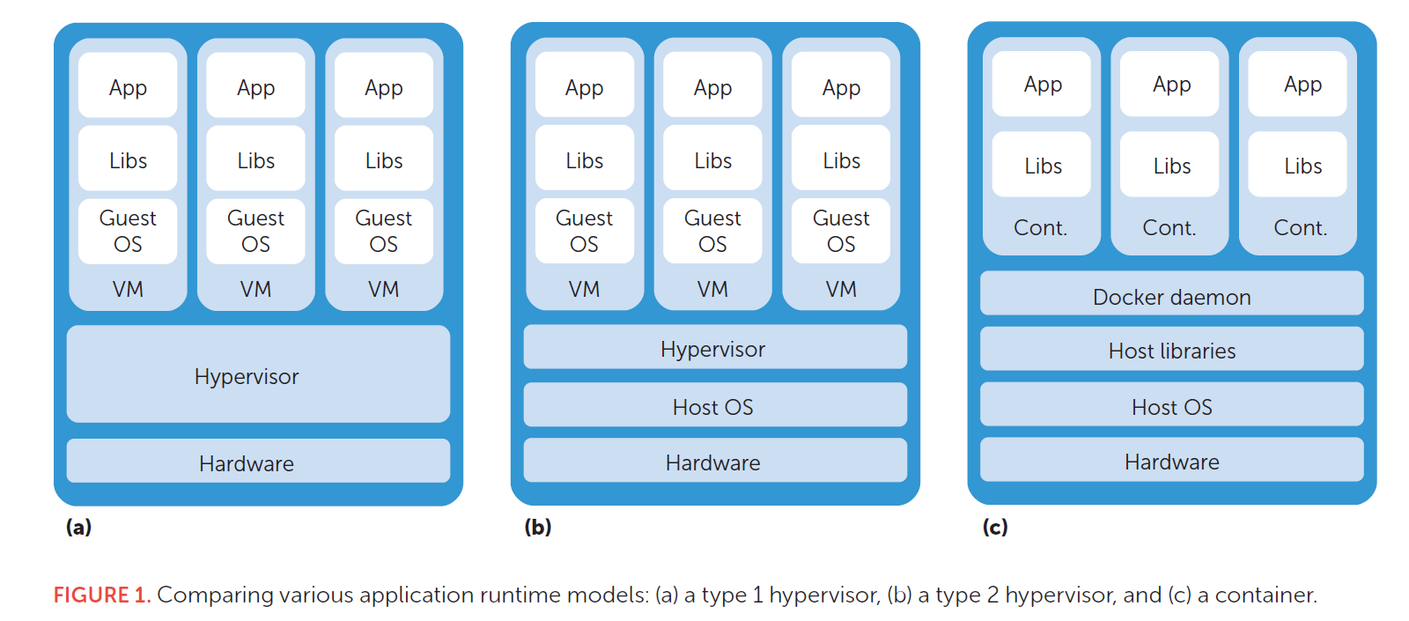
Containers
near-bare-metal performance
possibility of seamlessly running multiple versions of applications on the same machine

Slide 7
Linux Containers
Rely on kernel support
A userspace library to provide an interface to syscalls and frontend applications.
Two main kernel implementations
Linux container (LXC) implementations (using cgroups and namespaces)
the OpenVZ patch

Slide 8
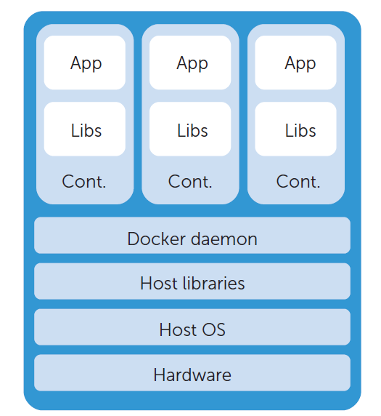
sharing the kernel
shortens the syscalls execution
share software resources
avoiding code duplication
lightweight(a few megabytes)
enables a quick boot process.

Slide 9
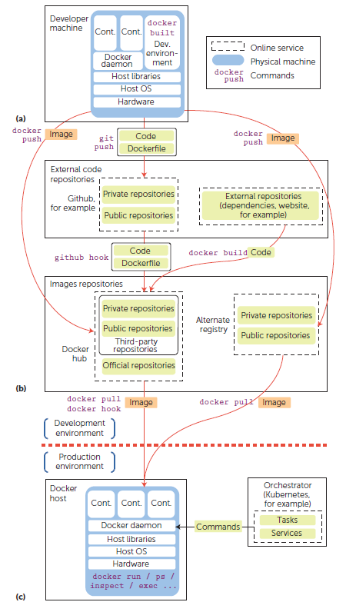
Docker
Specification
Internal
Daemon
Hub

Slide 10
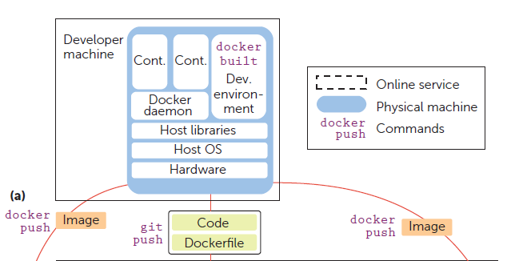
Docker specification
Container images
composed of a set of layers
metadata in the JSON format
Runtime
build images
docker run & docker commit
docker build(automate)

Slide 11
Docker internals
Wrapped, controlled environment
Kernel namespaces
split the view that processes have of the system
PID, IPC, NET, MNT, UTS, and USER
Control groups(cgroups)
restrict the resource
prevent resources wasting and starving
CPU shares, RAM, network bandwidth, disk I/O.

Slide 12
Docker daemon
Docker software runs as a daemon on the host machine.
Lauch container
control their isolation level
monitor them to trigger actions
Docker commit, build, and so on.

Slide 13
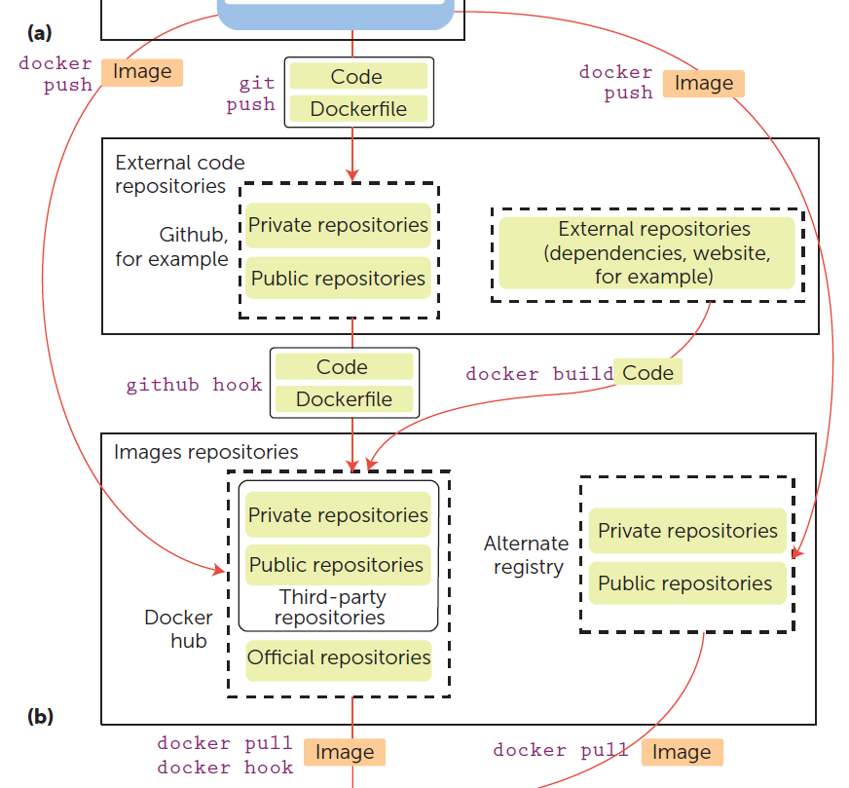
Docker hub
Online repository
Upload and download Docker images
Namespaced(developer/repository)

Slide 14
Docker Security Overview
Isolation of processes
Enforcement of this isolation
Network operations security

Slide 15
Isolation
Docker containers rely exclusively on Linux kernel features
Namespaces √ (default)
Cgroups (through -a -c options)
Capabilities √ (default)
All containers share the same network bridge (ARP poisoning attacks)
Global security can be lowered
–insecure-registry option (disable TLS)
–icc=false parameter (safe but rarely used)

Slide 16
Host Hardening
Host hardening through Linux kernel security modules enforces security-related limitation constraints imposed on containers.
SELinux
Apparmor
Seccomp
However, while default hardening protects the host from containers, it doesn’t protect containers from other containers.

Slide 17
Network Security
Docker uses network resources for image distribution and remote control of the Docker daemon.
Image distribution
verify image by hash
connection is made over TLS
Content Trust relies on the update framework (sign imagine, recover)
Remote control
Unix socket √ (default)
TCP socket (dangerous, needs TLS (–tlsverify))

Slide 18
Docker Usages: Security Challenges
Isolation of processes
Enforcement of this isolation
Network operations security

Slide 19
Docker Usages
A container must host a single service
A reproducible and automated deployment of applications
A way to ship complete virtual environments and update them regularly.
Tempting to perform administration tasks from within the container
Could require extra capabilities that Docker drops by default

Slide 20
Adversary Model
Direct adversaries can sniff, block, inject, or modify network and system communications, and they directly target the production machines. Locally or remotely.
Direct adversaries can compromise several system components:
In-production containers (DoS)
In-production host operating system (container escape attack)
In-production Docker daemons (lower the default security parameters)
The production network (redirect network traffic)

Slide 21
Adversary Model
Vulnerabilities found in Docker and the libcontainer mostly concern filesystem isolation.
Chroot escapes
Path traversals
Access to special file systems on the host
Because container processes often run with user ID 0, they have read and write access on the whole host filesystem when they escape, which lets them overwrite host binaries, leading to a delayed arbitrary code execution with root privileges.

Slide 22
Vulnerabilities Affecting Docker Usages
Insecure local configuration
Widespread usages take advantage of options, which gives containers extended access to the host
Along with these runtime container options, several settings on the host can influence potential attacks
Weak local access control
Mandatory access control have room for improvement
Gives containers complete access in default
Image distribution vulnerabilities
Compromising a code repository

Slide 23
Thanks for listening Q&A

